Slide 1
ANALYZING ADVERTISING CAMPAIGN PERFORMANCE
Riffat Adnan | Shannon Allotey | Vinay Madhugiri | Christine Thomas

Slide 2
Table of contents
01
02
03
04
Intro to Ad Campaigns
Our Methods
Our Results
Conclusion

Slide 3
01
Intro to Ad Campaigns
"In the world of advertising, the best campaigns aren’t the ones with the biggest budgets – they’re the ones backed by the smartest data."

Slide 4
Goals of Advertising Campaigns
Brand Awareness
Calls to Action
Reach a broad audience of potential consumers
Persuade potential consumers to engage in a particular action

Slide 5
Key Metrics
Conversions
Click-Through Rate
(CTR)
Cost-per-Click
(CPC)
The rate at which consumers engage with the ads
The intended outcome of the advertising campaign
The amount spent to get a single engagement

Slide 6
Other Considerations
Platform
Format
Demographic
Region

Slide 7

02
Method

Slide 8
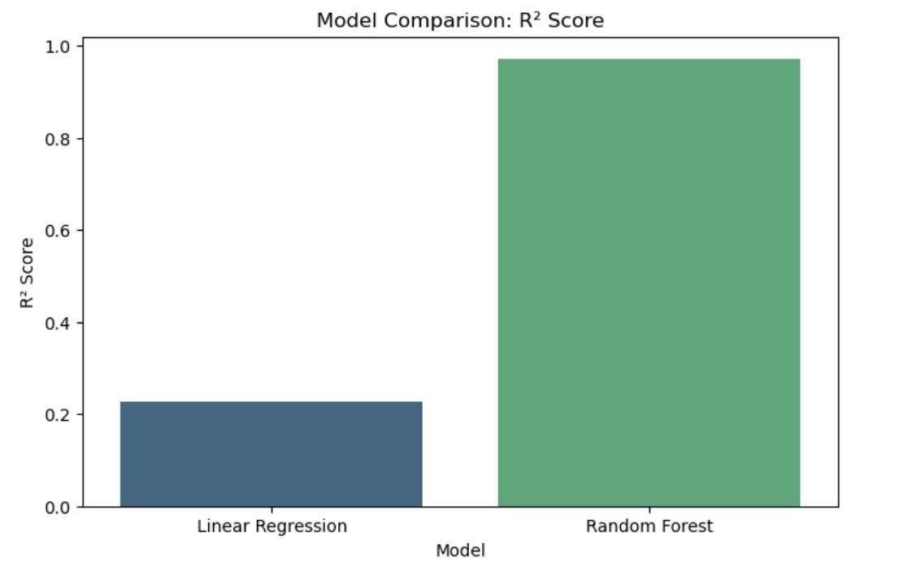
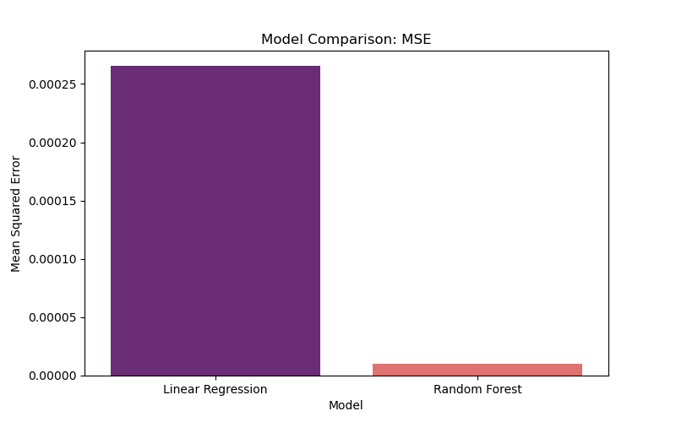
Model Comparison

Slide 9
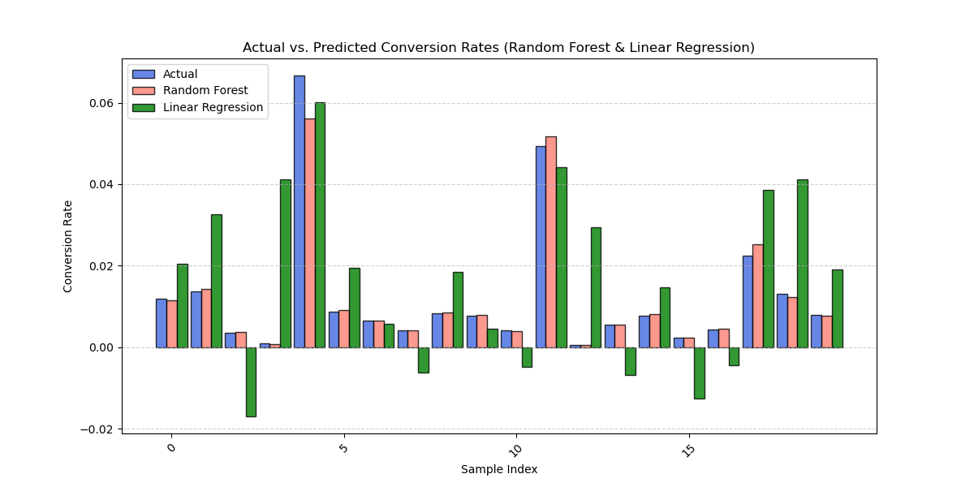
Model Comparison
OVERVIEW
Random Forest (RF) is more accurate
Linear Regression (LR) struggles
RF is more stable across different samples, making it the better model.

Slide 10

03
Results

Slide 11
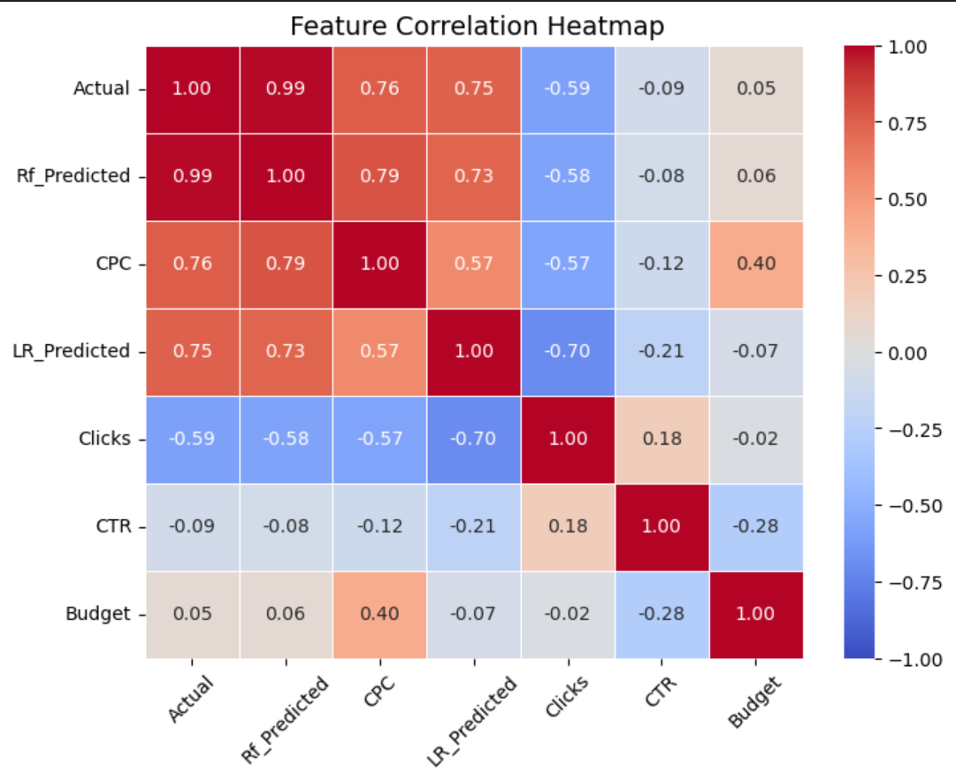

Slide 12
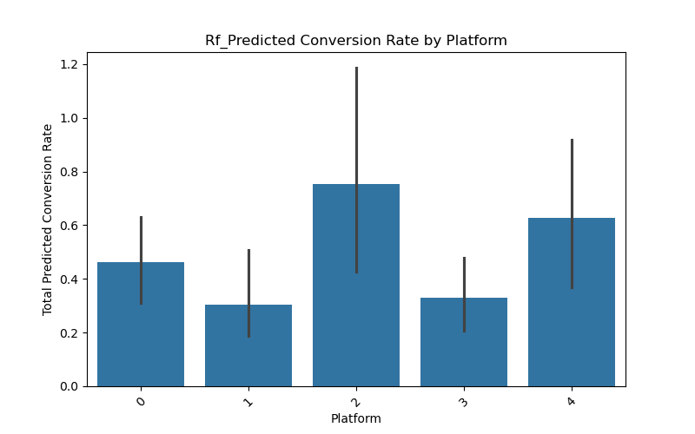
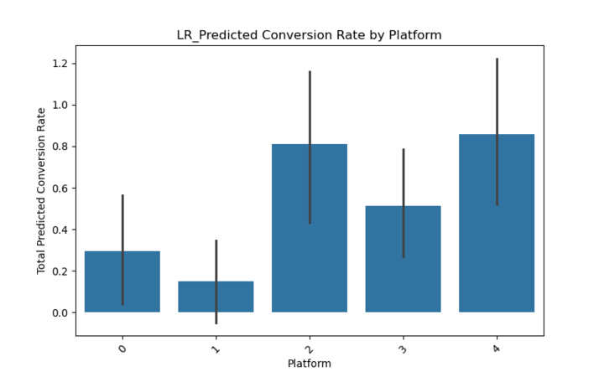
Key findings
Top performers
Underperformers
Model Comparison
Random Forest vs. Linear Regression
Which model is better
Actionable Next Steps
What platform to double down on
What platform to re-evaluate

Slide 13
04
Conclusion

Slide 14
Providing a Data-Driven Road Map
Smarter, Faster, More Profitable
Powered by a Random Forest Algorithm
Scalable and Future-Proof

Slide 15
Thanks
Do you have any questions?

Slide 16

Resources
Advertising Campaign Performance Dataset: A Synthetic Dataset for Predicting Ad Campaign Success
By Akshay Choudhary

